Slide 1



MERN – ES6 + React
Module 07: JavaScript Basics

Slide 2
Outline
Module 07
JavaScript Basics
Understanding concepts of Connecting JavaScript
Understanding concepts of Operators
Understanding concepts of Control Flow
Understanding concepts of While Loops
Understanding concepts of For Loops

Slide 3
Outline
Frontend Web Development (Interactivity) - JavaScript
JavaScript basics
JavaScript ES6
JavaScript in DOM and BOM
JavaScript Web APIs

Slide 4
JavaScript basics

Slide 5
JavaScript - interactivity
What Can JavaScript Do?
JavaScript Can Change HTML Content
JavaScript Can Change HTML Attribute Values
JavaScript Can Change HTML Styles (CSS)
JavaScript Can Hide/Show HTML Elements (DOM/BOM)
Send/Receive data

Slide 6
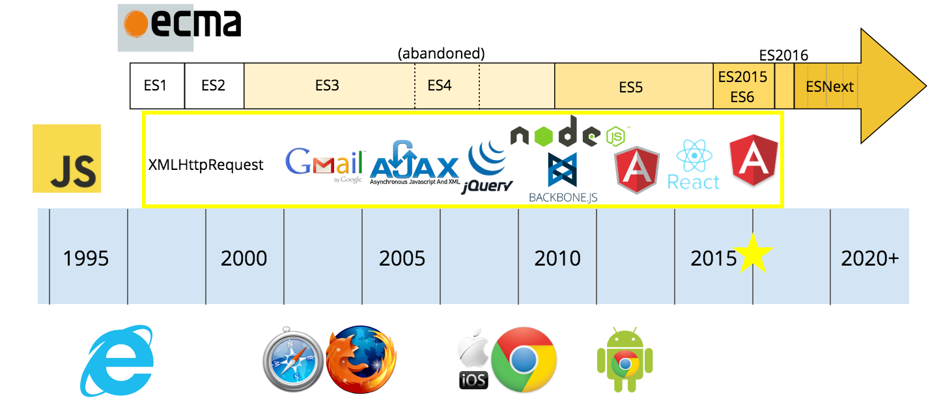
History of JavaScript
JavaScript Basics
Notes:
The Golden Age of JavaScript. How “Browser Wars”, open-source and… | by Mike Adams | mgadams

Slide 7
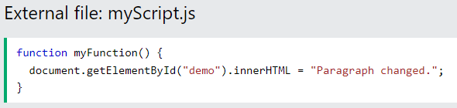

JavaScript Where to Put code
JavaScript basics
The <script> Tag
In HTML, JavaScript code is inserted between <script> and </script> tags. Example.
JavaScript in <head> or <body>
You can place any number of scripts in an HTML document.
Scripts can be placed in the <body>, or in the <head> section of an HTML page, or in both.
Placing scripts at the bottom of the <body> element improves the display speed, because script interpretation slows down the display. Example.
External JavaScript

Slide 8
JavaScript Output
JavaScript basics
Writing into an HTML element, using innerHTML. Example.
Changing the innerHTML property of an HTML element is a common way to display data in HTML.
Writing into the HTML output using document.write(). Example. Note.
For testing purposes, it is convenient to use document.write()
Writing into an alert box, using window.alert(). Example.
You can use an alert box to display data:
Writing into the browser console, using console.log(). Example.
For debugging purposes, you can call the console.log() method in the browser to display data.

Slide 9
JavaScript Programs
JavaScript basics
A computer program is a list of "instructions" to be "executed" by a computer.
In a programming language, these programming instructions are called statements.
A JavaScript program is a list of programming statements.
In HTML, JavaScript programs are executed by the web browser.
Details

Slide 10
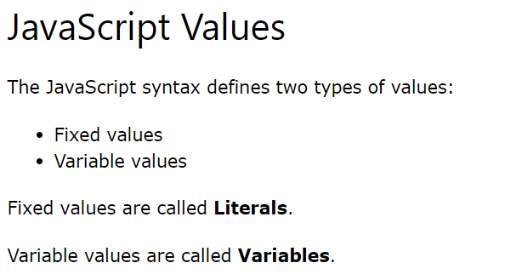
JavaScript Syntax
JavaScript basics
JavaScript syntax is the set of rules, how JavaScript programs are constructed:

Slide 11
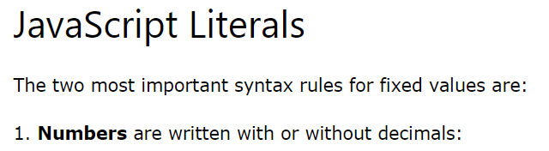
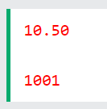
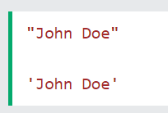
JavaScript Syntax
JavaScript basics
JavaScript syntax is the set of rules, how JavaScript programs are constructed:

Slide 12
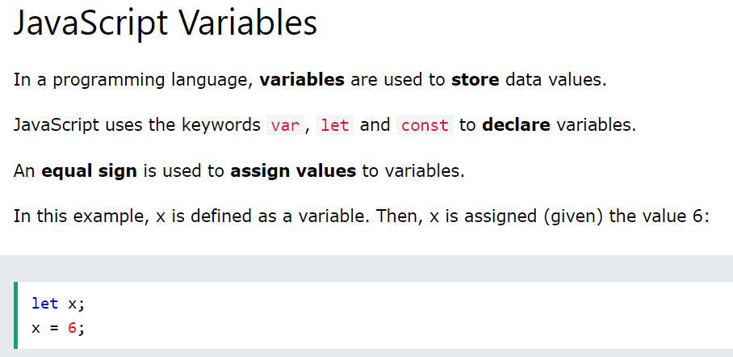
JavaScript Syntax
JavaScript basics
JavaScript syntax is the set of rules, how JavaScript programs are constructed:

Slide 13
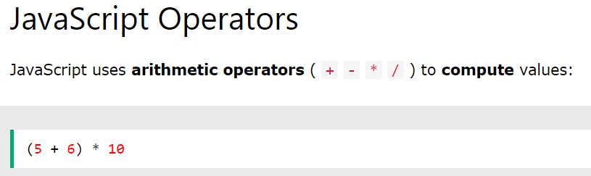
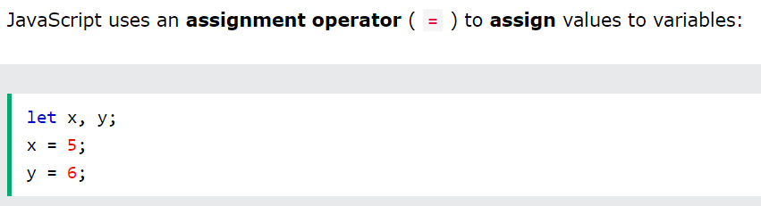
JavaScript Syntax
JavaScript basics
JavaScript syntax is the set of rules, how JavaScript programs are constructed:

Slide 14
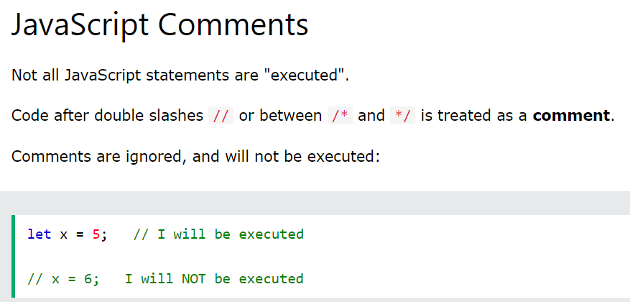
JavaScript Syntax
JavaScript basics
JavaScript syntax is the set of rules, how JavaScript programs are constructed:

Slide 15
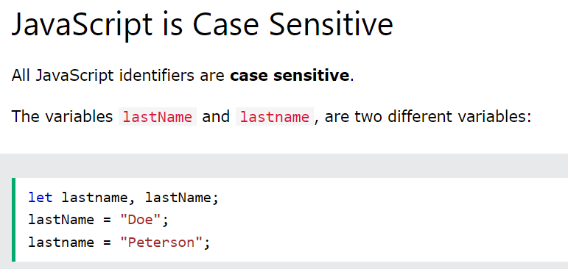
JavaScript Syntax
JavaScript basics
JavaScript syntax is the set of rules, how JavaScript programs are constructed:

Slide 16
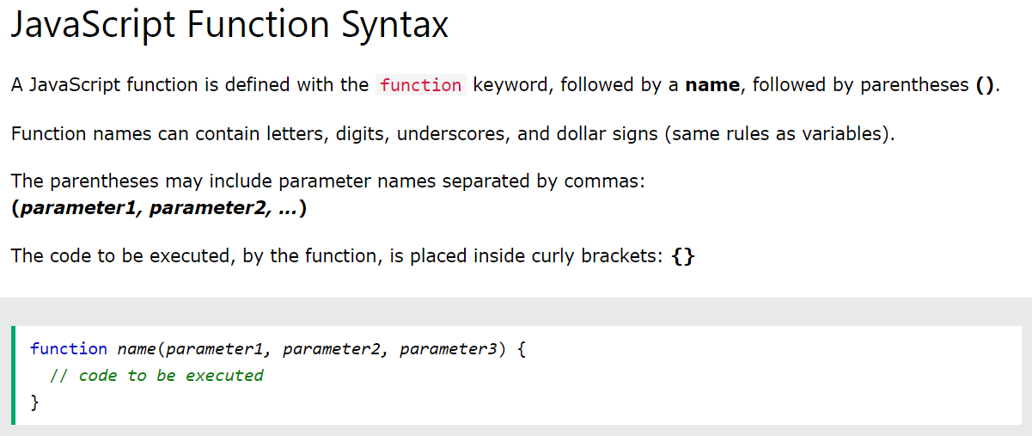
JavaScript Functions
A JavaScript function is a block of code designed to perform a particular task.

Slide 17
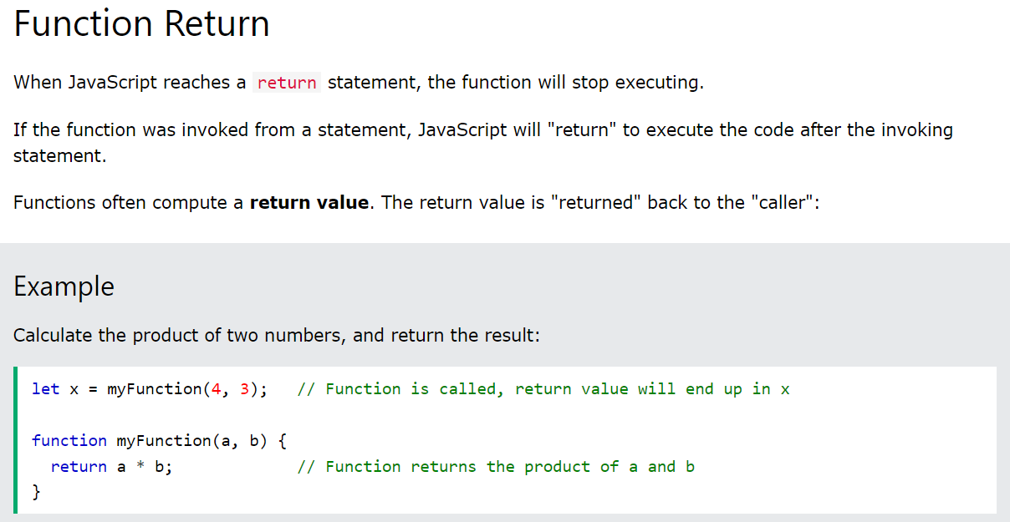
JavaScript Functions
A JavaScript function is a block of code designed to perform a particular task.

Slide 18
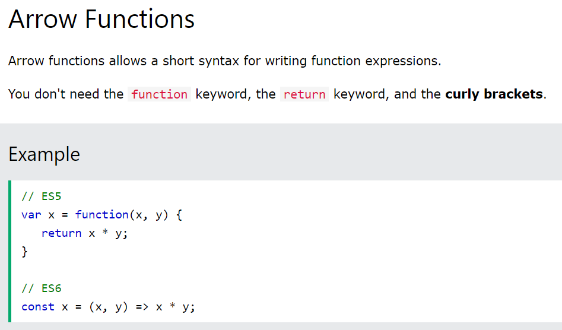
JavaScript Functions
A JavaScript function is a block of code designed to perform a particular task.
JavaScript Arrow Function (w3schools.com)

Slide 19
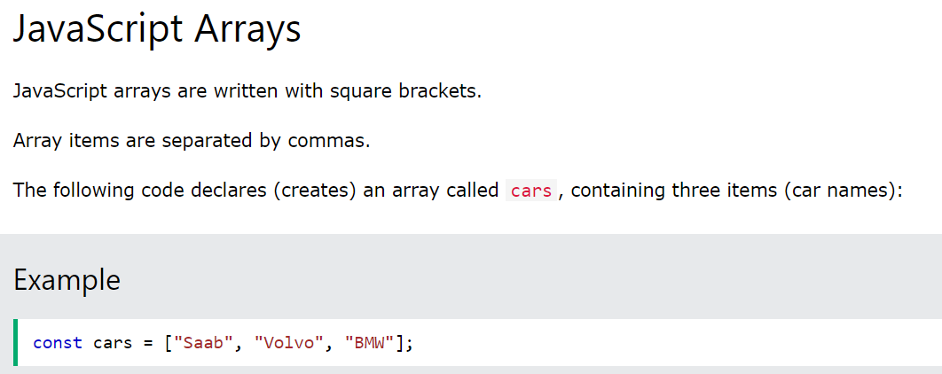
JavaScript Arrays
JavaScript basics

Slide 20
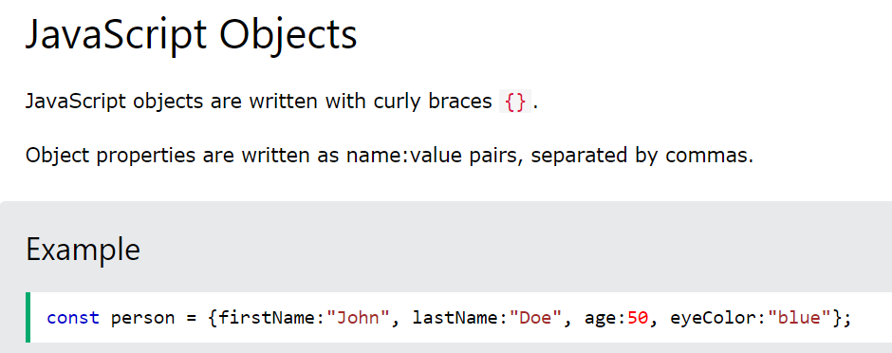
JavaScript Objects
JavaScript basics

Slide 21
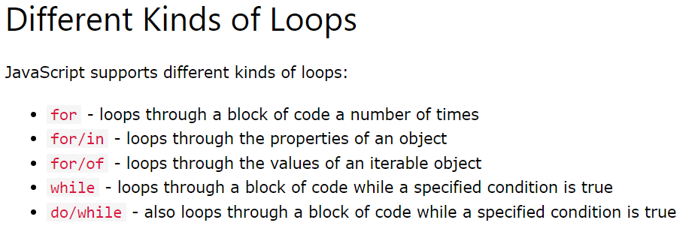
JavaScript Loops
JavaScript basics

Slide 22
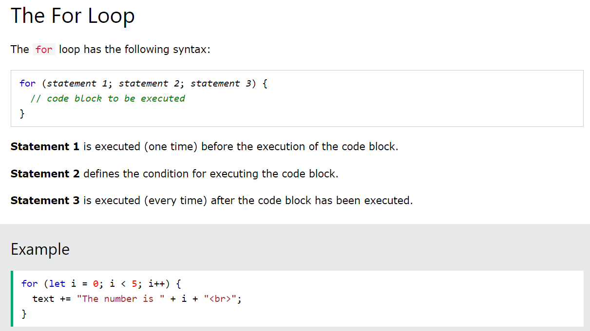
JavaScript Loops
JavaScript basics

Slide 23
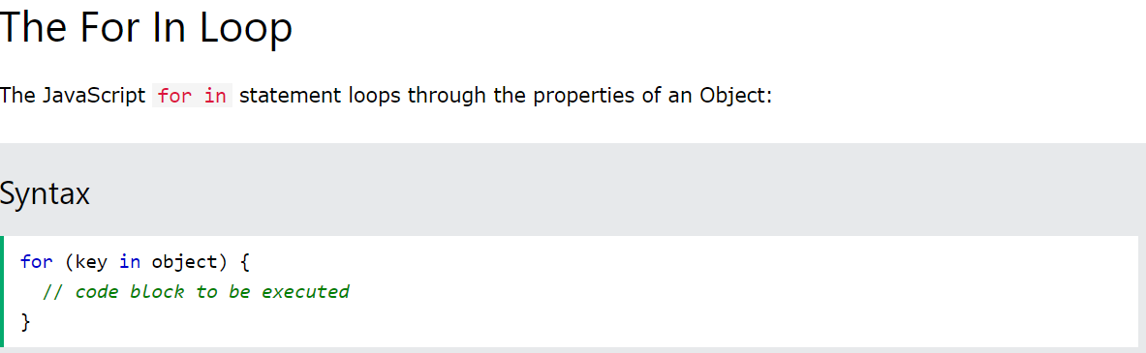
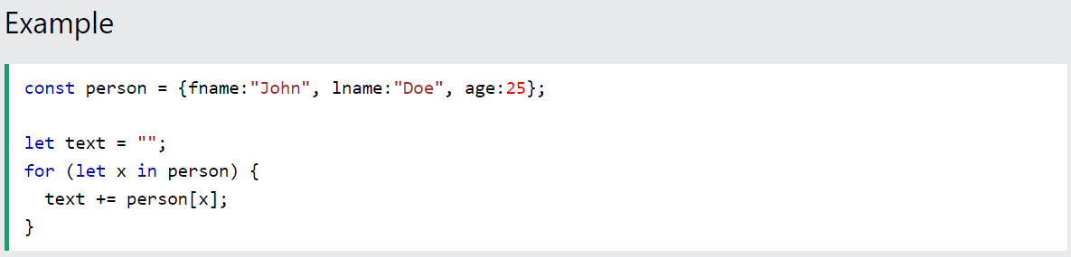
JavaScript Loops
JavaScript basics

Slide 24
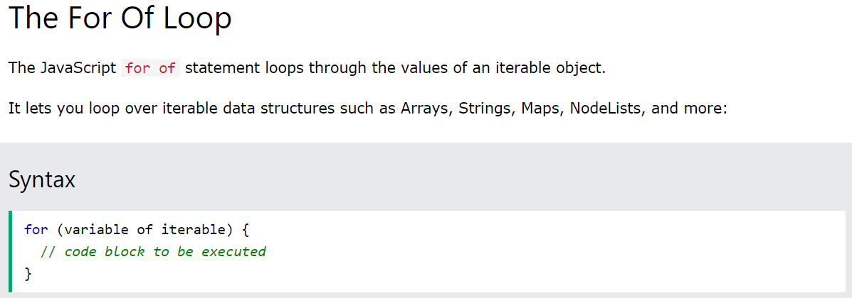
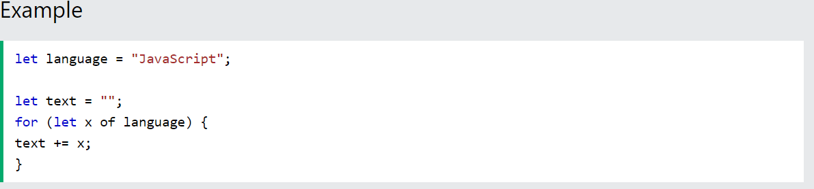
JavaScript Loops
JavaScript basics

Slide 25
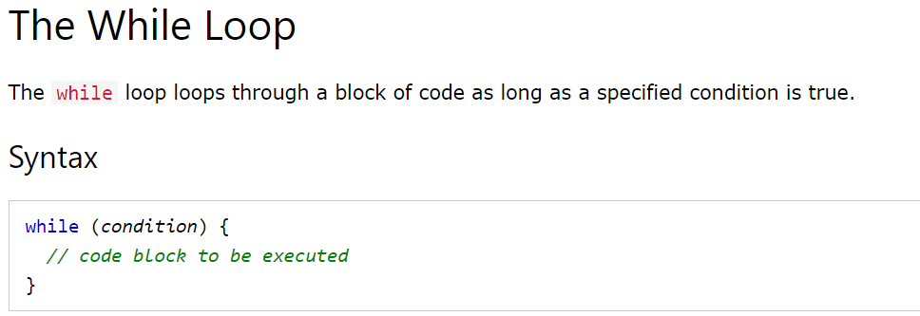
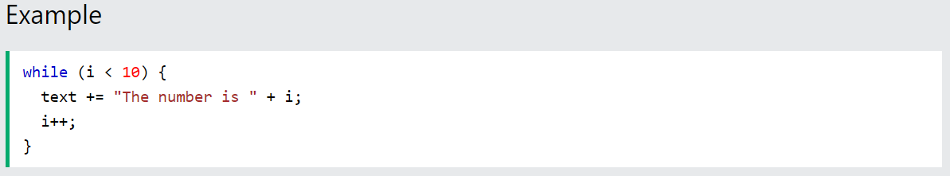
JavaScript Loops
JavaScript basics

Slide 26
JavaScript Where to Put code
JavaScript basics

Slide 27
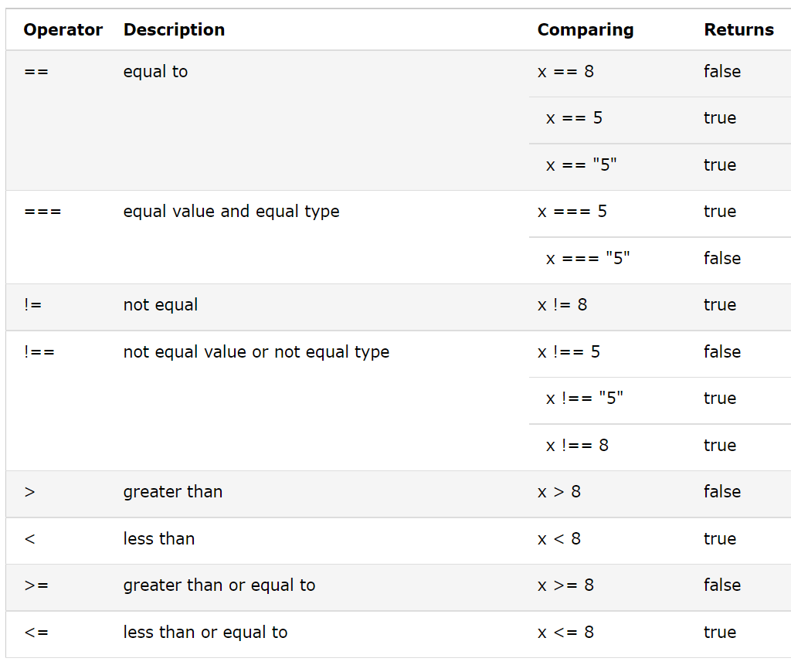
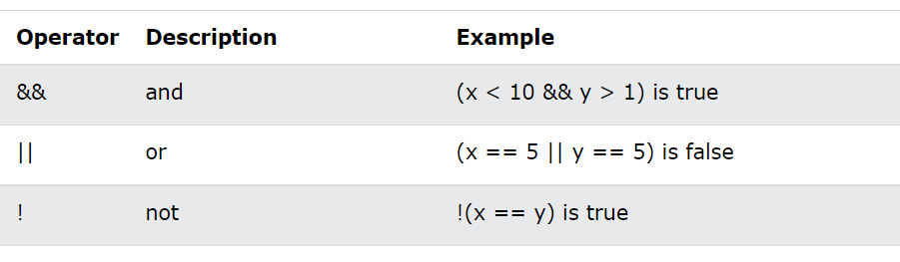
JavaScript Comparison and Logical Operators
JavaScript basics
Given that x = 5
Given that x = 6 and y = 3

Slide 28
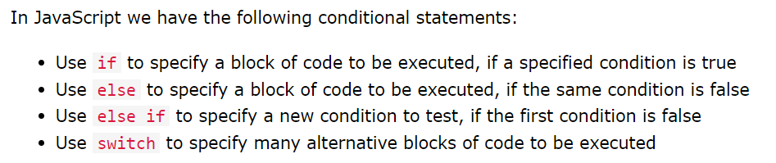
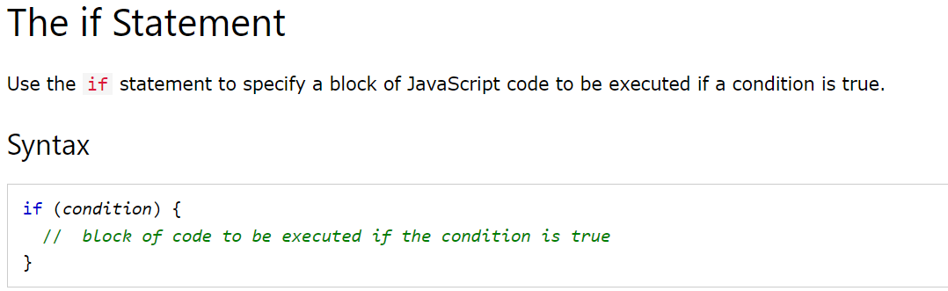
JavaScript Flow Control
JavaScript basics

Slide 29
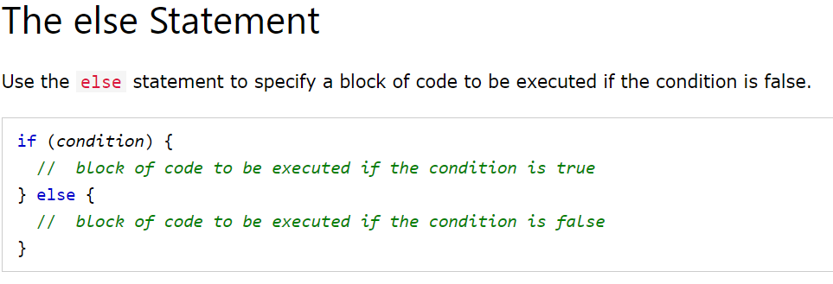
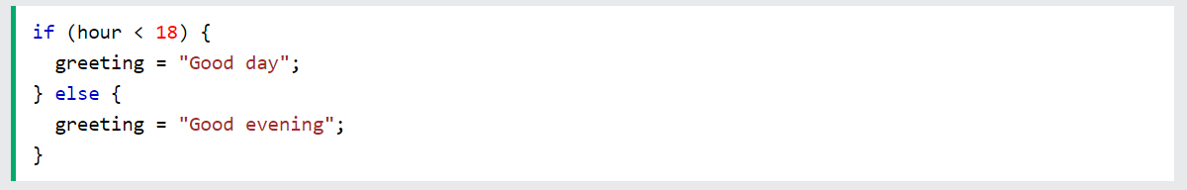
JavaScript Flow Control
JavaScript basics
Example

Slide 30
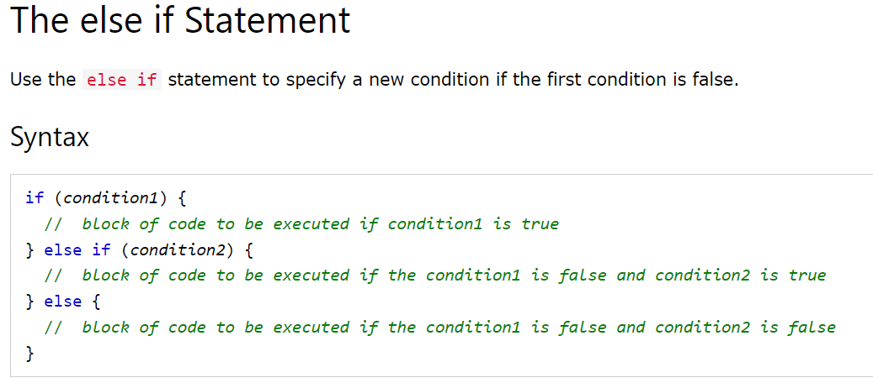
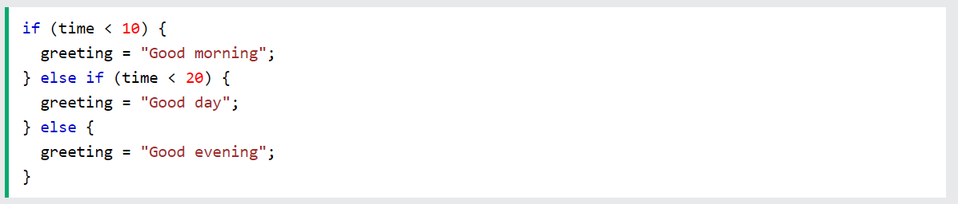
JavaScript Flow Control
JavaScript basics

Slide 31
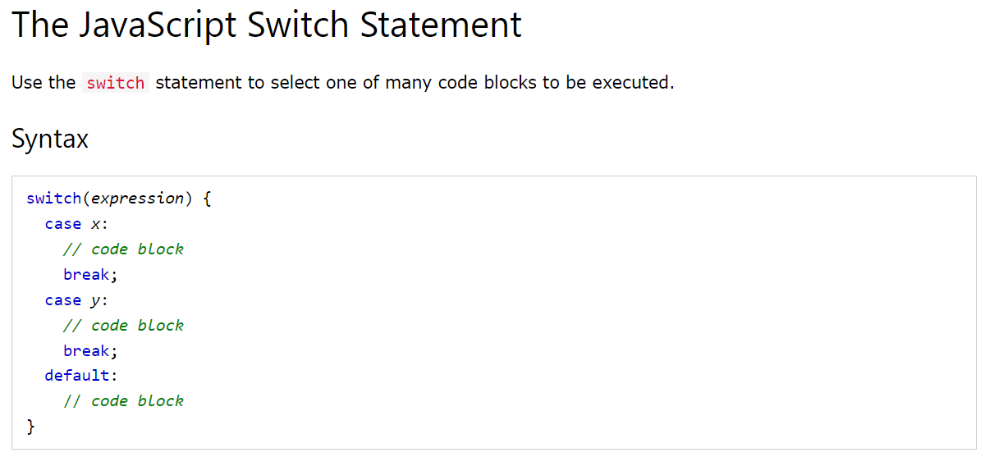
JavaScript Flow Control
JavaScript basics

Slide 32
JavaScript Flow Control
JavaScript basics

Slide 33
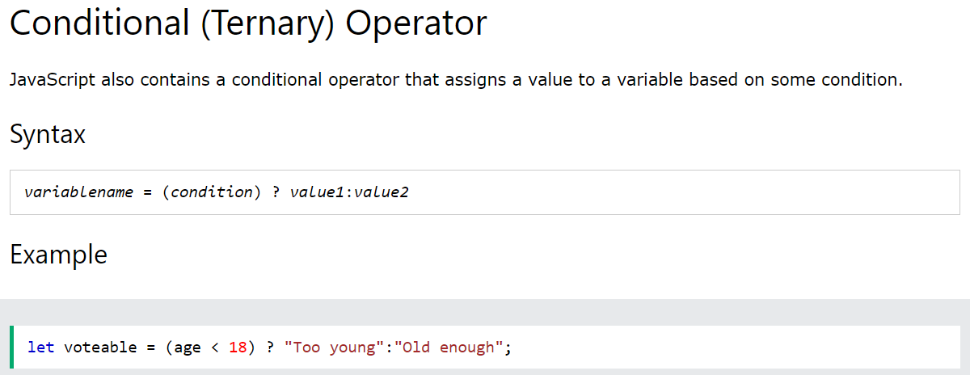
JavaScript Flow Control
JavaScript basics

Slide 34
Summary
Module 07
JavaScript Basics
Understanding concepts of Connecting JavaScript
Understanding concepts of Operators
Understanding concepts of Control Flow
Understanding concepts of While Loops
Understanding concepts of For Loops

